Slide 1

Learned Associations Mapping Cybersecurity Document Semantics with Linked Data
Daniel Montague
CY665 – Cybersecurity Capstone
Spring 2024 Master of Science in Cybersecurity
School of Technology & Computing (STC)
Notes:
Hi, my name is Dan Montague
I am in the Masters of Science in Cybersecurity program
My interests are in the intersection of knowledge management and cybersecurity
For the next few minutes, I would like to share with you a novel approach to automated knowledge management for security control assessment.

Slide 2
Agenda
Preview
Problem Statement
Research Question
Primer
Design
Approach
Results
Demo
Discussion
Future Work
Key References
Q&A
Notes:
Here is an overview of my brief presentation today.

Slide 3
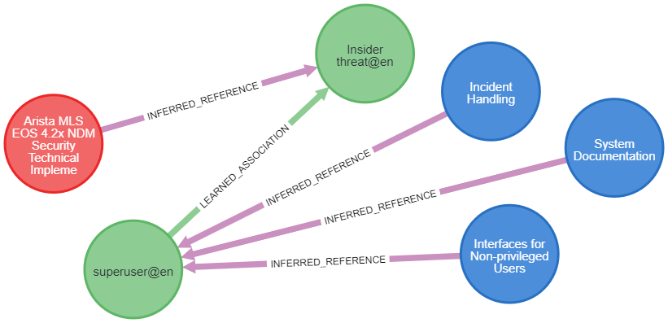
Preview
Notes:
This is a preview of the output from the program I developed.
The picture is a graph composed of nodes and edges.
The circles represent nodes and the arrows represent edges.
The red and the blue nodes are each parts of documents to compare.
In this case, the red nodes are DISA Security Technical Implementation Guides or STIGs
And the blue nodes are from NIST Risk Management Framework Revision 5
The green nodes are from Linked Open Data sources such as Wikidata or DBPedia
All of the edges connecting nodes to each other in this image have been inferred by the program.
This graph is a mapping of a STIG to RMF Security Control Catalogue,
but the approach should apply to any pair of conceptually related documents.

Slide 4
Problem Statement
It is often necessary to correlate elements of requiring documents like RMF to system policy and design documents.
When applying requirements to real systems, human interpretation is often required. This is a laborious and potentially error-prone process.
RMF Assessment processes would benefit from automated decision support.
Use Cases
Control Tailoring
Policy Control Verification
Notes:
Security analysts need to figure out how documents interact during the design and assessment steps within the RMF process.
As a case in point, if RMF poses a requirement and STIG shows how it should be implemented, we should try to bridge those automatically to reduce the need for human involvement by finding what I call association paths.

Slide 5

Research Question
Can we find association paths automatically?

Slide 6
Primer
RDF – Resource Description Framework
Structured, extensible representation for knowledge, expressed as SVO triples.
Used by LOD and as an interchange format to NeoSemantics
Neo4J – Graph DBMS
Used to store all data as a graph
NeoSemantics extension used to process RDF
LOD – Linked Open Data
Like Wikipedia for data, massive stores of RDF triples are available
As the name implies, objects in LOD are linked together
We can traverse the links to find association paths
Notes:
As a primer, in this project I use RDF or Resource Description Framework,
Neo4J as a graph Database management system,
And LOD or Linked Open Data

Slide 7
Design – Initial Data Load
Load two datasets to compare
RMF Rev. 5
RMF is available in Open Security Control Assessment Language (OSCAL), which I loaded using a method described by Koderman (2022)
STIG
STIGs are available via DISA. I downloaded all publicly available STIGs using a custom scraper, then manually mapped them into Neo4J
Notes:
I used readily available data as a proof of concept.
As previously mentioned, I’m looking for a mapping between RMF Rev. 5 and STIGs.

Slide 8

Design – Keyphrase Matching
I first derive a vocabulary of keyphrases from the documents using text processing (spaCy)
I search for keyphrase mentions in the original text against LODC SPARQL endpoints.
Results are often erroneous, so SBERT is used to select the closest match.
This conceptually approximates a human choosing the most closely related sentence containing a word, and that word's list of dictionary definitions.
Notes:
This slide describes the keyphrase matching approach, considering the context of the keyphrase mention.
Keyphrases eventually become the intermediate nodes in association paths.

Slide 9

Approach - Assumptions
Context Embedding
Vectorizing everything with the same model allows numerical comparisons.
Entity Resolution
Definition most cosine-similar to the original context is probably the best for that mention.
Association Pathways
Materializing associations between LODC nodes mentioned together can create pathways between related concepts for later traversal.
Notes:
These are the assumptions that drove the development of the keyphrase matcher.
I assume that context embeddings from a pretrained language model are useful for numerical comparison
I assume that cosine similarity of those embeddings is a good representation of how related the concepts are
I assume that building a path of such connections is a way to represent conceptual links

Slide 10

Approach (Recap)
Extract Keyphrase Vocabulary from Prose in Loaded Datasets
Load Datasets
RMF
STIG
Find Keyphrase Mentions in Prose
Resolve Keyphrase Mentions Against Linked Open Data
Notes:
To recap, the process so far is to
1. load the datasets into Neo4J in a suitable format,
2. Extract keyphrase vocabulary from prose in those documents
3. Find mentions of those keyphrases in the original prose text, and
4. Locate the best matching Linked Open Data definition for that mention, with respect to context.

Slide 11
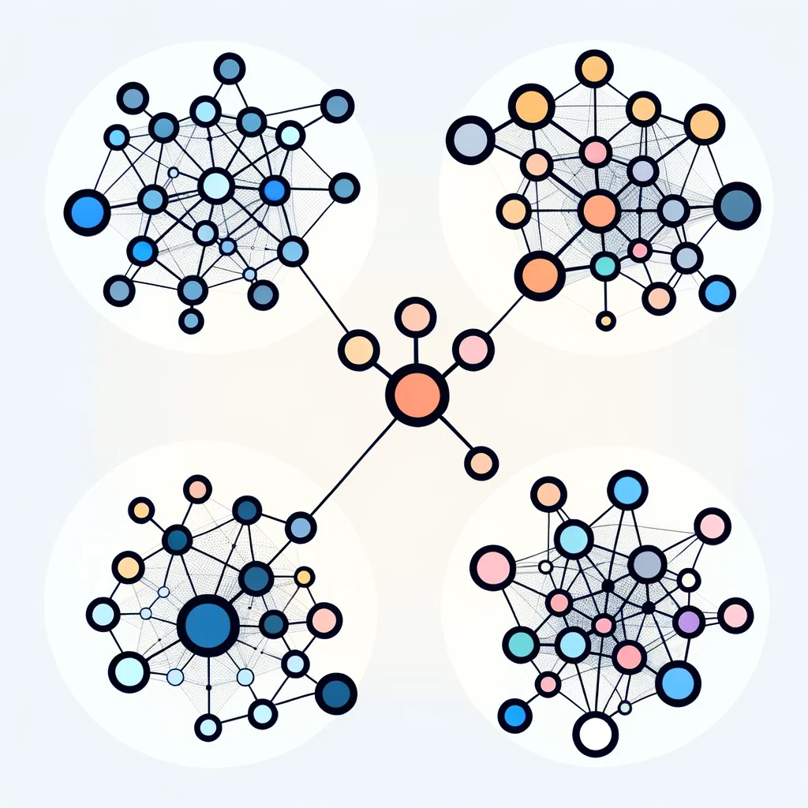
Approach – Materialize LOD Definitions
Once keyphrases are matched to LOD
Relevant RDF is retrieved using NeoSemantics
Graph algorithms link the LOD node to that mention
Over time, this builds a tree-like sample of LOD per endpoint
“Learned Associations” build paths between branches and trees
Notes:
Once keyphrases have been matched, the next step is to materialize the matching Linked Open Data definitions for each keyphrase mention.
Due to time limitations, I couldn’t examine the Linked Open Data structure, so I opted to use what I’m calling “Learned Associations” as a proxy.
So, what are learned associations?

Slide 12
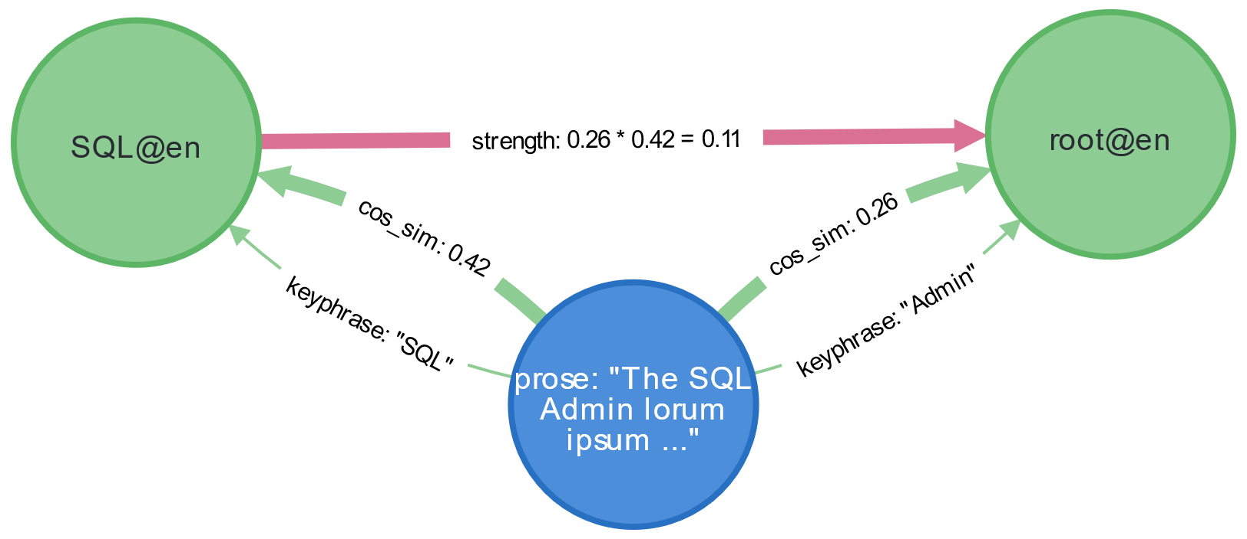
Approach – Learned Associations
Learned associations are created when two keyphrases are mentioned in the same field (direct coreference) and have a “strength” property
Learned associations can be filtered by strength
Notes:
A learned association is an inference drawn by the program about what concepts are related to one another.
This is necessary because the tree-like structure of LOD does not guarantee suitable paths between definitional nodes.
Learned associations are created when two keyphrases are mentioned in the same field.
Note that in this example, the keyphrase “Admin” matches the Linked Open Data node for “root” because root’s description was the most cosine similar.
Learned associations have a strength computed as the product of the cosine similarities of their contributing mentions. If an existing learned association would be assigned a lesser strength than it already has, it keeps the existing value instead.
This has the added benefit of creating another filter for strong associations only.

Slide 13
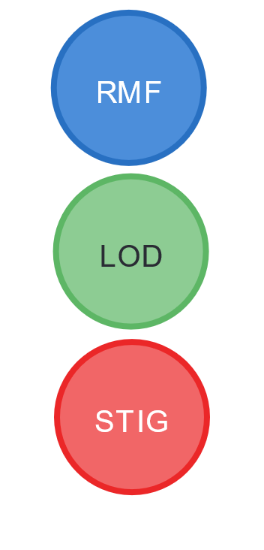
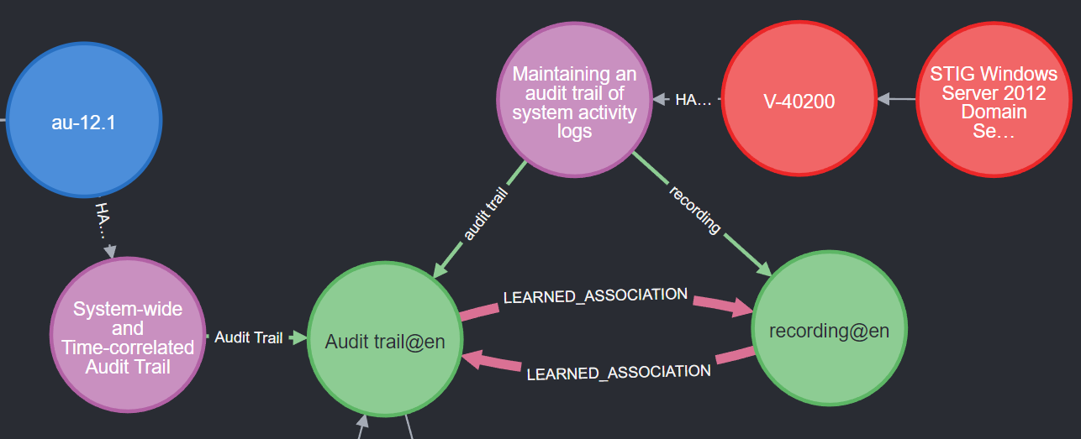
Results
Learned associations build association pathways between documents.
Notes:
Pictured is the end product of automatic association.
This is an association path across both a direct coreference of the keyphrase “audit trail” and an indirect coreference of “recording” and “audit trail” across the learned association.
Several of these association pathways occurring together should be evidence of conceptual relatedness of those document elements.
This image on its own is weak evidence that RMF security control AU-12 enhancement 1, the blue node, is applicable to the Windows Server 2012 STIG, the upper right red node, and therefore the systems to which that STIG would apply.

Slide 14
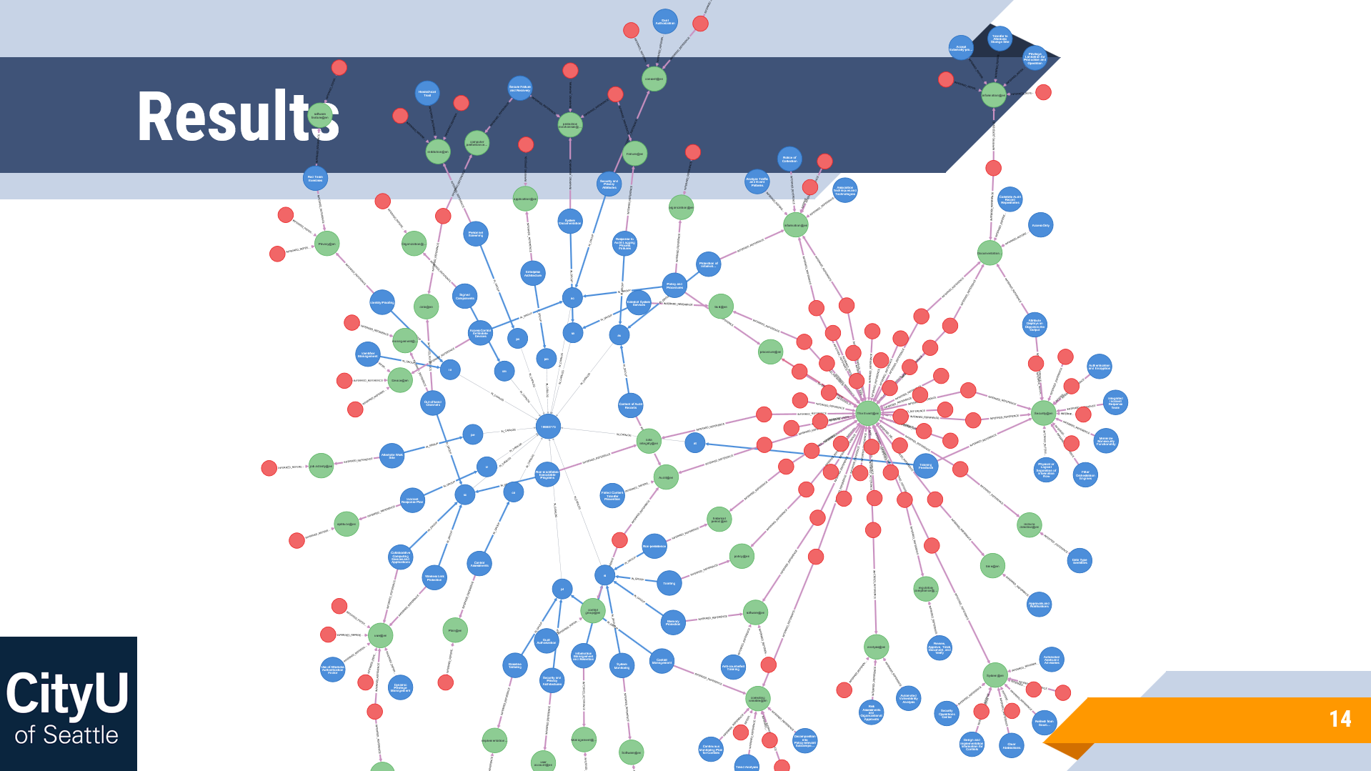
Demo

Slide 15
Discussion
The answer to the research question:
Can we find association paths automatically?
Yes, observe this slide’s background
I believe this approach could be developed to apply to arbitrary pairs of documents.
There are many present and future ways in which LOD could enrich this process beyond simply defining keyphrases. This is just the beginning.

Slide 16
Future Work
Leverage internal LOD structure
Current approach relies on coreference in the same language
Identify Useful Relations within LOD
Other relations already present in LOD should be useful for document linking
These relations are already retrieved but not used in the program
Requires deeper understanding of each LODC ontology
Interoperable structure of RDF makes this likely to work
Extend to Language Independence
LOD is often linked across languages.
Handling it requires a suitable polyglot language model to generate consistent embeddings

Slide 17

Repository
All code, queries and data will be made available on GitHub by this weekend.
https://github.com/DMonCityU/associative-mapping

Slide 18
Key References
Berzovitis, A.-M. (2024). Amberzovitis/GraphKer [Cypher]. https://github.com/amberzovitis/GraphKer (Original work published 2021)
Heier, M., & Morales, A. (2020). Quantifying the Risk Management Framework [Naval Postgraduate School]. https://apps.dtic.mil/sti/pdfs/AD1114564.pdf
Koderman, A. (2022, September 6). 5—Cybersecurity Automation with OSCAL and Neo4J. https://www.youtube.com/watch?v=FVCFmSIsYic
MITRE Corporation, Kaloroumakis, P., & Smith, M. (2021). Toward a Knowledge Graph of Cybersecurity Countermeasures. In https://d3fend.mitre.org/. https://d3fend.mitre.org/resources/D3FEND.pdf
Poozhithara, J. J., Asuncion, H. U., & Lagesse, B. (2023). Keyword Extraction from Specification Documents for Planning Security Mechanisms. Proceedings of the 45th International Conference on Software Engineering, 1661–1673. https://doi.org/10.1109/ICSE48619.2023.00143
Reimers, N., & Gurevych, I. (2019). Sentence-BERT: Sentence Embeddings using Siamese BERT-Networks (arXiv:1908.10084). arXiv. https://doi.org/10.48550/arXiv.1908.10084

Slide 19


Q&A

